Slide 1















THANKS to ALL
of our GENEROUS SPONSORS
DIAMOND
GOLD
SILVER
Notes:
1

Slide 2

Women & Wealth
10/19/2017
Lisa A. Chapman, CFP®, CIMA®, CRPS®
Managing Director – Wealth Management
Wealth Advisor
CBM Wealth Management
www.ubs.com/team/cbmwm
1

Slide 3
Agenda
Women & Wealth – The Global View
Case study – Emily
Wealthy women – How they make it and keep it

Slide 4
Women & Wealth: The Global View
3

Slide 5

Women as primary decision makers over household assets
66%
United Kingdom
44%
87%
United States
80%
China
India
80%
80%
Hong Kong
Singapore
Source: Center for Talent Innovation
"Power of the Purse" – 2014
*Promotion of all women primary decision makers over household assets when in a relationship
Notes:
Proportion of women (out of all women) who are primary decision makers over household assets when in a relationship
As a truly global wealth manager, UBS is uniquely positioned to service this client base

Slide 6
Women & Wealth: By the Numbers
27% of world's wealth is controlled by women
85% of all U.S. consumer purchases are made by women
40% of U.S. businesses are owned by women
45% of millionaires in the U.S. are women
70% of total inheritance dollars in the U.S. will go to women first in next 40 years
80% of all women will be in charge of household finances at some point in their lives
Moffitt, Andrea T. & Hewlett, Sylvia Ann. "Harness the Power of the Purse: Winning Women Investors" (2015). Rare Bird Books.
Palmer, K. "The Finance Industry's Plan to Court Women Customers" (Oct 15, 2014).
Notes:
Women own 40% of US businesses, with an annual economic impact of $3 trillion. This is larger than the GDPs of France, Italy, and GB combined.
Women own/operate 25-33% of all private businesses worldwide
Account for 85% of all consumer purchases in the U.S.
70% of the estimated $59 trillion in inheritance will move into women's hands over the next 40 years
Women control $ 20 trillion, or 27% of the world's wealth

Slide 7
Billionaire Women Globally
164%
The percentage increase in female billionaires from 2003 (44) to 2013 (116)
UBS/PwC Billionaire Report, 2015

Slide 8
Overall Women are not a Monolithic Market
Earned It
Inherited It
Married It
59%
22%
20%
of U.S. women with over $1 Million in assets in their names
Women differ in financial confidence, financial acumen and risk appetite due to differences in geography, generation, wealth level, and source of wealth.
Center for Talent Innovation
"Power of the Purse" – 2014
Notes:
Women surveyed had $1M or more in assets held to their names
Highly nuanced female market based on:
Geography
Generation
Wealth level
Source of wealth
Longer average life expectancies – women have a longer life expectancy than men. Those who reach age 65 are on average expected to live 2.3 years longer than a man who reaches the same age
Lower incomes during working years – despite greater income parity, women receive nearly 1/3 less compensation than men over their lifetimes
Lower saving levels – women have lower account balances than men. This is a major problem because women who retired in 2012 are expected to spend 15% more time in retirement than men (20.5 yrs vs 17.9)
2013 Ameriprise study: 47% of women have contributed to a 401(k) plan vs. 55% of men
Wells Fargo report: 43% of men are saving at the recommended "contribution index" level (a target rate of 10% including employer match) vs. 39% of women
Source: "Teach Your Daughters Money Lessons They Will Never Forget" (Nancy Anderson on 5/08/2014)
Higher medical costs – women have higher chance than men of being impacted financially by chronic or terminal illnesses. These expenses, combined with an overall prolonged lifespan, can place excessive pressure on Higher taxes – 80% of women will be single in their final year and as a result, have a higher tax rate than married couples do. Being that married women are also more likely to be the surviving spouse, they may end up managing finances alone when before they may have been managed with the help of their partner

Slide 9
Shared Characteristics: More Time, Less Money
Longer life expectancies
  On average, women live about 7 years longer than men
  Women are expected to spend 15% more time in retirement than men (20.5 years for women compared to 17.9 years for men)
Higher medical costs and final tax liabilities
  Women constitute 66.8% of the nursing home population
    Manisha Thakor and Sharon Kedar, On my Own Two Feet, 2007.
Social Security Administration. [Online] 2015. http://www.ssa.gov/planners/lifeexpectancy.htm.
    Society at a glance 2014: OECD Social Indicators. S.l.: OECD Publishing, 2014.
    Women: investing with a Purpose – Why women Investors May Need a Different Approach to Reach Their goals. Perishing LLC, 2015. 9.
    Nursing Home Data Compendium 2013 Edition. Department of Health and Human Services. (2013).
Notes:
Longer average life expectancies – women have a longer life expectancy than men. Those who reach age 65 are on average expected to live 2.3 years longer than a man who reaches the same age
Lower incomes during working years – despite greater income parity, women receive nearly 1/3 less compensation than men over their lifetimes
Lower saving levels – women have lower account balances than men. This is a major problem because women who retired in 2012 are expected to spend 15% more time in retirement than men (20.5 yrs vs 17.9)
2013 Ameriprise study: 47% of women have contributed to a 401(k) plan vs. 55% of men
Wells Fargo report: 43% of men are saving at the recommended "contribution index" level (a target rate of 10% including employer match) vs. 39% of women
Source: "Teach Your Daughters Money Lessons They Will Never Forget" (Nancy Anderson on 5/08/2014)
Higher medical costs – women have higher chance than men of being impacted financially by chronic or terminal illnesses. These expenses, combined with an overall prolonged lifespan, can place excessive pressure on Higher taxes – 80% of women will be single in their final year and as a result, have a higher tax rate than married couples do. Being that married women are also more likely to be the surviving spouse, they may end up managing finances alone when before they may have been managed with the help of their partner

Slide 10
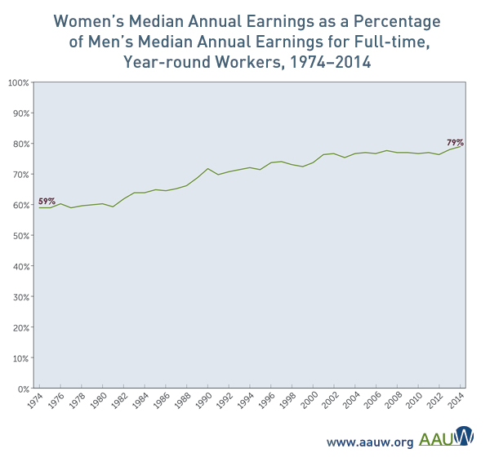
Shared Characteristics: More Time, Less Money
Lower incomes during working years leads to lower saving levels
  Women still make 79 cents on a man's dollar
  Less income earned means less social security paid during retirement
Source: http://www.aauw.org/research/the-simple-truth-about-the-gender-pay-gap/
Notes:
According to AAUW survery, it is partially because women don't ask for more money and because women step away from career advancement opportunities when it interferes with family commitments

Slide 11
Shared Financial Confidence & Literacy
If women are financially literate, why aren't they financially confident?
Center for Talent Innovation
"Power of the Purse" – 2014

Slide 12
Shared Gaps in Risk Aversion
What makes women risk averse?
Center for Talent Innovation
"Power of the Purse" – 2014

Slide 13
Case Study - Emily
12

Slide 14
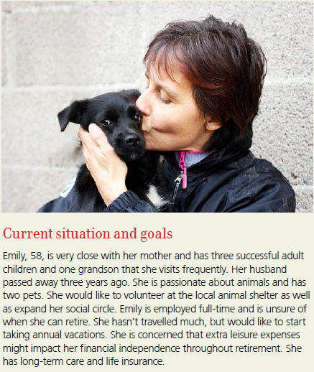
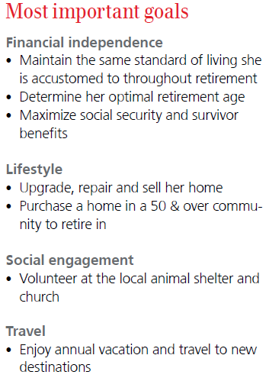
Meet Emily

Slide 15

Emily's guide to financial life management
Advice. Beyond investing.
plan Create a plan, align life & financial goals
access Cash flow, spending, budget
save Retirement, education, healthcare, longevity
borrow Strategic use of debt
grow* Asset allocation, risk management, compensation optimization
protect* Insurance, trusts, tax strategies
give Family, charity
*Investing involves risks, including the potential of losing money or the decline in value of the investment. Performance is not guaranteed.
Notes:
Financial Advisor talking points:
When we’re putting together your financial plan—or when we’re reviewing it—we can help you with more than you realize—not just your portfolio. Because your financial life is more than your investments. That’s why we take a comprehensive approach. We call it: Advice. Beyond investing.
We’ve already talked about planning. It's the first step in our ongoing conversation to developing a clear, actionable roadmap and adapting it as circumstances change.
Access is about connecting you with your assets when you need them, and more efficient ways to manage your money.
Saving includes growing your assets for what’s important to you. Whether it’s education, retirement, healthcare or longevity—longevity is important here. You should consider what you’ll need if you live a long time. Women live longer. So planning for longevity within your financial plan is going to be very important.
Borrowing involves intelligent solutions that enable you to get the credit you can count on, the way you want it. For example, there is good debt and bad debt, and appropriate levels of debt.
Grow means aligning your investment objectives with your goals, seeking to build your assets.
Protect includes not just insurance protection, but investment solutions that can help reduce market risk and private banking solutions that can help preserve your wealth. These days, it also applies to your identity and protecting yourself against fraud.
And finally, giving means the ability to make a lasting impact through estate planning, building a legacy that spans generations and giving while living. We know from our work that estate planning and giving are issues that matter to both women and men.
Together, all these pieces make up a solid plan for your future. One that we can help you build together.

Slide 16
Wealthy women – How they make it and keep it
15

Slide 17
Wealthy women – How they make it and keep it
The right perspective on time
A strong defense against uncertainty
A belief that failure equals learning
A commitment to Work Hard, Work First and Play When Appropriate
A sense of purpose

Slide 18

CBM Wealth Management
Experience you can count on
Dedicated to helping individuals and corporations pursue financial success, Lisa Chapman, Natalie Barron and Lindsay Mais provide their clients with personalized service and quality investment advice.
Backed by the research and resources of one of the world's leading financial services firms, this team helps develop customized strategies designed to address specific needs and goals for both corporate and individual clients.

Slide 19
Contact information
  Lisa Chapman, CFP®, CIMA®, CRPS®
  Managing Director – Wealth Management
  Wealth Advisor
  562-343-9216
  lisa.chapman@ubs.com
  Natalie Barron, CFP®, CRPS®
  Vice President – Wealth Management
  Portfolio Manager
  562-343-9242
  natalie.barron@ubs.com
UBS Financial Services Inc.
3030 Old Ranch Parkway, Suite 300
Seal Beach, CA 90740
Toll Free: 800-343-6084
Direct: 562-343-9216
www.ubs.com/team/cbmwm
  Lindsay Mais, CFP®, RP®
  Financial Advisor
  Corporate Stock Benefit Consultant
  562-343-9226
  lindsay.mais@ubs.com
  Michael Mais, RP®
  Wealth Strategy Associate
  562-343-9184
  michael.mais@ubs.com
  Shannon Appleby
  Senior Registered Client Service Associate
  Associate Director
  562-343-9185
  shannon.appleby@ubs.com
  Tracy Givant
  Client Service Associate
  562-343-9231
  tracy.givant@ubs.com

Slide 20
Important information
It is important that you understand the ways in which we conduct business and the applicable laws and regulations that govern us. As a firm providing wealth management services to executives in the U.S., we are registered with the U.S. Securities and Exchange Commission as an investment adviser and a broker-dealer, offering both investment advisory and brokerage services. Though there are similarities among these services, they are separate and distinct, differ in material ways and are governed by different laws and separate contracts.
In providing a financial plan, we may act as a broker-dealer or investment adviser, depending on whether we charge a fee for the service. Financial plans provided free of charge are a service incidental to our brokerage relationship and the service terminates upon delivery of the plan. We provide financial planning services as an investment adviser for a separate fee pursuant to a written agreement, which details the terms, conditions, fee and scope of the engagement. For information about our fee-based financial planning services, see the Firm's Financial Planning ADV Disclosure Brochure. Note that financial planning does not alter or modify in any way the nature of a executive’s UBS accounts, their rights and our obligations relating to these accounts or the terms and conditions of any UBS account agreement in effect during or after the financial planning service. executives are not required to establish accounts, purchase products or otherwise transact business with us to implement any of the suggestions made in the financial plan. Should a executive decide to implement their financial plan with us, we will act as either a broker-dealer or an investment adviser, depending on the service selected. For more information on the distinctions between our brokerage and investment advisory services, please speak with your Financial Advisor or visit our website at www.ubs.com/workingwithus.
Wealth Management services in the United States are provided by UBS Financial Services, Inc., a registered broker/dealer offering securities, trading, brokerage and related products and services.
Depending on your needs we can help you implement your retirement strategies through both our brokerage and advisory capabilities.
In providing financial planning services, we may act as a broker-dealer or investment adviser, depending on whether we charge a fee for the service. The nature and scope of the services are detailed in the documents and reports provided to clients as part of the service. Financial planning does not alter or modify in any way a client’s existing account(s) or the terms and conditions of any account agreements they may have with UBS.
Certified Financial Planner Board of Standards Inc. owns the certification marks CFP® and CERTIFIED FINANCIAL PLANNER™ in the U.S.
CIMA® is a registered certification mark of the Investment Management Consultants Association, Inc. in the United States of America and worldwide.
For designation disclosures visit https://www.ubs.com/us/en/designation-disclosures.html
©UBS 2017. All rights reserved. UBS Financial Services Inc. is a subsidiary of UBS AG. Member FINRA/SIPC

Slide 21
Important information
The information and data presented may be deemed reliable; however, their accuracy and completeness is not guaranteed by UBS Financial Services Inc.
Insurance products are made available by UBS Financial Services Insurance Agency Inc. or other insurance licensed subsidiaries of UBS Financial Services Inc. through third-party unaffiliated insurance companies.
Neither UBS Financial Services Inc. nor its employees (including its Financial Advisors) provide tax or legal advice. You should consult with your legal counsel and/or your accountant or tax professional regarding the legal or tax implications of a particular suggestion, strategy or investment, including any estate planning strategies, before you invest or implement.
Borrowing using securities as collateral entails risk and may not be appropriate for your needs. Please review the Loan Disclosure Statement that will be included in your application package for more information.
110419-2927-001
ubs.com
UBS Financial Services Inc. is a subsidiary of UBS Group AG

